Slide 1
Computer Graphics: 2D – Point & Line Drawing
Tommy Marrinan, PhD

Slide 2
2D Drawing
Models exist in world-space
World-space exists on the infinite XY-plane
Screen exists in view-space
2D view-space is a rectangular region on the XY-plane
Discretized into a regular grid to make up the framebuffer
For now: world-space and view-space align

Slide 3
Point Drawing
Simple and straight forward
To draw point at location (x,y), illuminate the pixel at index [x][y] in the framebuffer
Draw point (5,5) dark red

Slide 4
Line Drawing
Given 2 endpoints of a line segment, which pixels should be illuminated?
Draw line from (1,2) to (6,5) dark red

Slide 5
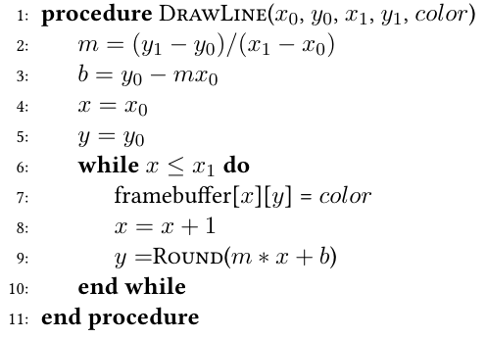
First Attempt
Use the line equation!
y = mx+b

Slide 6
More Efficient Way
Midpoint Line Drawing Algorithm (Bresenham)
Only uses integer arithmetic
No Round()
Need an alternate form of the line equation
0 = (𝚫y)x − (𝚫x)y + (𝚫x)b
Iteratively select which pixel to illuminate next
Only 2 options need to be considered

Slide 7
More Efficient Way
Options
(x₀+1, y₀)
(x₀+1, y₀+1)
Try the midpoint
(x₀+1, y₀+½)
Likely not on the line, therefore alternate line eq. not 0
If positive: closer to pixel above (x₀+1, y₀+1)
If negative: closer to pixel on same row (x₀+1, y₀)

Slide 8
More Efficient Way
Still have floating point arithmetic
Look at differences between consecutive points
Start point to next pixel midpoint
D = (A(x₀+1) + B(y₀+½) + C) − (Ax₀ + By₀ + C) = (Ax₀ + A + By₀ + ½B + C) − (Ax₀ + By₀ + C) = A + ½B
A = 𝚫y, B = −𝚫x, C = (𝚫x)b

Slide 9
More Efficient Way
Still have floating point arithmetic
Look at differences between consecutive points
One pixel midpoint to the next pixel midpoint
D₀ = (A(x₀+2) + B(y₀+½) + C) − (A(x₀+1) + B(y₀+½) + C) = A
D₁ = (A(x₀+2) + B(y₀+1½) + C) − (A(x₀+1) + B(y₀+½) + C) = A + B
A = 𝚫y, B = −𝚫x, C = (𝚫x)b

Slide 10
More Efficient Way
Remember – only concerned with sign of D!
Double all values
Initial value of D = 2A + B
Subsequent values of D₀ = 2A, or D₁ = 2A + 2B
No more fractions!

Slide 11
More Efficient Way
Which D to use on subsequent iterations?
Keep running error on how much above/below the midpoint actual line is
D itself stores the error!
If D ≤ 0 (line on/below the midpoint), increment D by D₀
If D > 0 (line above the midpoint), increment D by D₁

